Slide 1
Project Assignment
A case study

Slide 2
Outline
Introduction
CEO
Sales Manager
Store Manager

Slide 3
Introduction
We are working on:
Super Store Sales orders dataset from 2011 to 2014 (kaggle)
Worldwide sales
Different type of products
51290 orders

Slide 4
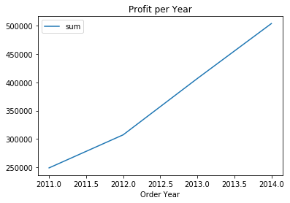
CEO
Profit are growing constantly. Since 2012 we can notice a positive shift in that growth.

Slide 5
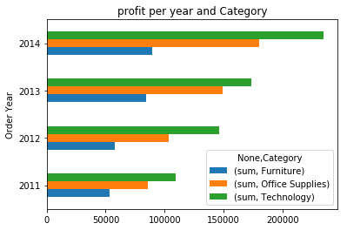
CEO
In terms of profit, most of the profit is coming from technology products. But furniture's profits are almost stable. Why does furniture products bring less profit ?

Slide 6
CEO
Row ID | Postal Code | Sales | Quantity | Discount | Profit | Shipping Cost | Order Year
Row ID | 1 | 0.00967103 | -0.0438889 | -0.173483 | 0.0875941 | -0.0190371 | -0.0390782 | -0.000920929
Postal Code | 0.00967103 | 1 | -0.0238538 | 0.0127607 | 0.0584431 | -0.0299612 | -0.0254491 | 0.00453869
Sales | -0.0438889 | -0.0238538 | 1 | 0.313577 | -0.0867219 | 0.484918 | 0.768073 | -0.00290483
Quantity | -0.173483 | 0.0127607 | 0.313577 | 1 | -0.0198747 | 0.104365 | 0.272649 | -0.00504926
Discount | 0.0875941 | 0.0584431 | -0.0867219 | -0.0198747 | 1 | -0.31649 | -0.0790556 | -0.00589394
Profit | -0.0190371 | -0.0299612 | 0.484918 | 0.104365 | -0.31649 | 1 | 0.354441 | 0.00262627
Shipping Cost | -0.0390782 | -0.0254491 | 0.768073 | 0.272649 | -0.0790556 | 0.354441 | 1 | -0.00313638
Order Year | -0.000920929 | 0.00453869 | -0.00290483 | -0.00504926 | -0.00589394 | 0.00262627 | -0.00313638 | 1
Profit is mostly correlated to shipping cost, sales and discount. But the highest correlation is linked to the sales; so the profit depends on the sales. Let's then see closer these sales.

Slide 7
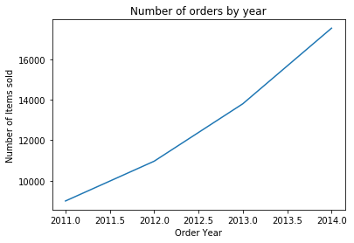
Sales Manager
Number of orders
Order Year
2011 | 8998
2012 | 10962
2013 | 13799
2014 | 17531
The number of orders are growing normally.

Slide 8
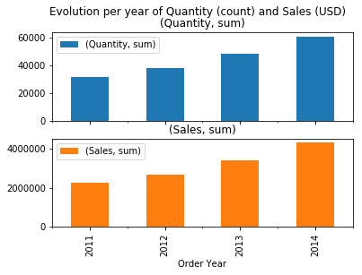
Sales Manager
Quantity of sold items and sales values are constatly growing from 2011 to 2014.

Slide 9
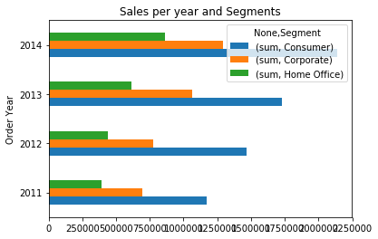
Sales Manager
By watching closely we can see that Consumer sales are the main in terms of share of sales and Home Office sales are the last.

Slide 10
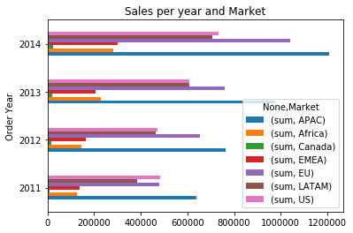
Sales Manager
Asia and Pacific (APAC) Countries a the leading areas in terms of sales, closely followed by European Union (EU)

Slide 11
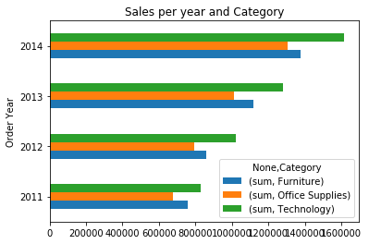
Sales Manager
Sales are also focused on technological products, even if the gap between categories are not that much

Slide 12
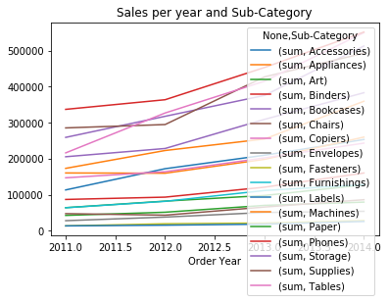
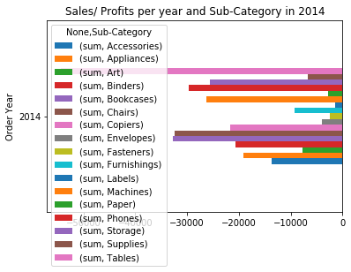
Sales Representative
But as loss of profit we can see that in 2014 the company is losing more than 54 thousands usd.

Slide 13
Sales Representative

